Slide 1


CS 153: Concepts of Compiler Design September 10 Class Meeting
Department of Computer Science San Jose State University Fall 2020 Instructor: Ron Mak
www.cs.sjsu.edu/~mak

Slide 2
DFA for a Pascal Identifier or Number
private static final int matrix[][] = {
/* letter digit + - . E other */
/* 0 */ { 1, 4, 3, 3, ERR, 1, ERR },
/* 1 */ { 1, 1, -2, -2, -2, 1, -2 },
/* 2 */ { ERR, ERR, ERR, ERR, ERR, ERR, ERR },
/* 3 */ { ERR, 4, ERR, ERR, ERR, ERR, ERR },
/* 4 */ { -5, 4, -5, -5, 6, 9, -5 },
/* 5 */ { ERR, ERR, ERR, ERR, ERR, ERR, ERR },
/* 6 */ { ERR, 7, ERR, ERR, ERR, ERR, ERR },
/* 7 */ { -8, 7, -8, -8, -8, 9, -8 },
/* 8 */ { ERR, ERR, ERR, ERR, ERR, ERR, ERR },
/* 9 */ { ERR, 11, 10, 10, ERR, ERR, ERR },
/* 10 */ { ERR, 11, ERR, ERR, ERR, ERR, ERR },
/* 11 */ { -12, 11, -12, -12, -12, -12, -12 },
/* 12 */ { ERR, ERR, ERR, ERR, ERR, ERR, ERR },
};
Negative numbers
in the matrix are the
accepting states.
letter
0
letter
1
[other]
2
digit
+
-
digit
E
digit
digit
digit
digit
.
+
3
4
6
digit
7
E
9
10
digit
11
[other]
12
digit
-
[other]
[other]
Notice how the
letter E is handled!
5
8

Slide 3
A Simple DFA Scanner
public class SimpleDFAScanner
{
// Input characters.
private static final int LETTER = 0;
private static final int DIGIT = 1;
private static final int PLUS = 2;
private static final int MINUS = 3;
private static final int DOT = 4;
private static final int E = 5;
private static final int OTHER = 6;
private static final int ERR = -99999; // error state
private static final int matrix[][] = { ... };
private char ch; // current input character
private int state; // current state
...
}

Slide 4
A Simple DFA Scanner, cont’d
int typeOf(char ch)
{
return (ch == 'E') ? E
: Character.isLetter(ch) ? LETTER
: Character.isDigit(ch) ? DIGIT
: (ch == '+') ? PLUS
: (ch == '-') ? MINUS
: (ch == '.') ? DOT
: OTHER;
}

Slide 5
A Simple DFA Scanner, cont’d
private String nextToken()
throws IOException
{
while (Character.isWhitespace(ch)) nextChar();
if (ch == 0) return null; // EOF?
state = 0; // start state
StringBuilder buffer = new StringBuilder();
while (state >= 0) { // not accepting state
state = matrix[state][typeOf(ch)]; // transit
if ((state >= 0) || (state == ERR)) {
buffer.append(ch); // build token string
nextChar();
}
}
return buffer.toString();
}
This is the
heart of the
scanner.
Table-driven scanners
can be very fast!

Slide 6
A Simple DFA Scanner, cont’d
private void scan()
throws IOException
{
nextChar();
while (ch != 0) { // EOF?
String token = nextToken();
if (token != null) {
System.out.print("=====> \"" + token + "\" ");
String tokenType =
(state == -2) ? "IDENTIFIER"
: (state == -5) ? "INTEGER"
: (state == -8) ? "REAL (fraction only)"
: (state == -12) ? "REAL"
: "*** ERROR ***";
System.out.println(tokenType);
}
}
}
How do we know which token we just got?
Demo

Slide 7
Backus Naur Form (BNF)
A text-based way to describe source language syntax.
Named after John Backus and Peter Naur.
Text-based means it can be read by a program.
Example: A compiler-compiler that can automatically generate a parser and a scanner for a source language after reading the language’s syntax rules written in BNF.

Slide 8
Backus Naur Form (BNF), cont’d
Uses certain meta-symbols.
Symbols that are part of BNF itself but are not necessarily part of the syntax of the source language.
::= | “is defined as”
| | “or”
< > | Surround names of nonterminal (not literal) items

Slide 9
BNF Example: U.S. Postal Address
<postal-address> ::= <name-part> <street-part> <city-state-part>
<name-part> ::= <first-part> <last-name>
| <first-part> <last-name> <suffix>
<first-part> ::= <first-name> | <capital-letter> .
<suffix> ::= Sr. | Jr. | <roman-numeral>
<street-part> ::= <house-number> <street-name>
| <house-number> <street-name> <apartment-number>
<city-state-part > ::= <city-name> , <state-code> <ZIP-code>
<first-name> ::= <name>
<last-name> ::= <name>
<street-name> ::= <name>
<city-name> ::= <name>
<house-number> ::= <number>
<apartment-number> ::= <number>
<state-code> ::= <capital-letter> <capital-letter>
<capital-letter> ::= A|B|C|D|E|F|G|H|I|J|K|L|M |N|O|P|Q|R|S|T|U|V|W|X|Y|Z
<name> ::= …
<number> ::= …
etc.
Mary Jane 123 Easy Street San Jose, CA 95192

Slide 10
BNF: Optional and Repeated Items
To show optional items in BNF, use the vertical bar |.
Example: “An expression is a simple expression optionally followed by a relational operator and another simple expression.”
<expression> ::= <simple expression>
| <simple expression> <rel op> <simple expression>

Slide 11
BNF: Optional and Repeated Items
BNF uses recursion for repeated items.
Example: “A digit sequence is a digit followed by zero or more digits.”
<digit sequence> ::= <digit> | <digit> <digit sequence>
Right
recursive
<digit sequence> ::= <digit> | <digit sequence> <digit>
Left
recursive
Be wary of left recursion in practice.

Slide 12
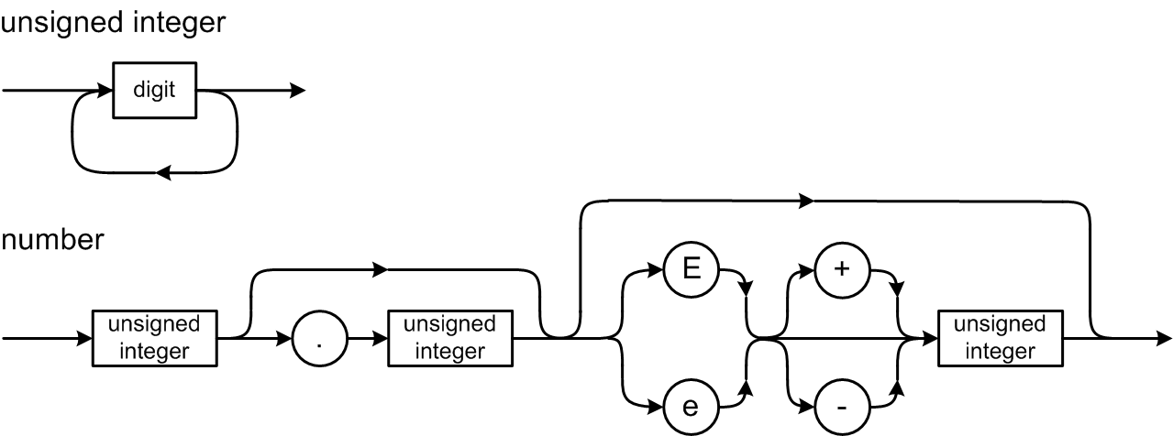
BNF Example: Pascal Number
<digit sequence> ::= <digit>
| <digit> <digit sequence>
<unsigned integer> ::= <digit sequence>
<unsigned real> ::= <unsigned integer>.<digit sequence>
| <unsigned integer>.<digit sequence> <e> <scale factor>
| <unsigned integer > <e> <scale factor>
<scale factor> ::= <unsigned integer> | <sign> <unsigned integer>
<e> ::= E | e
<sign> ::= + | -
<number> ::= <unsigned integer> | <unsigned real>
Repetition via recursion.
The sign
is optional.

Slide 13
BNF Example: Pascal IF Statement
<if statement> ::= IF <expression> THEN <statement>
| IF <expression> THEN <statement> ELSE <statement>
It should be straightforward to write a parsing method from either the syntax diagram or the BNF.

Slide 14
Grammars and Languages
A grammar defines a language.
Grammar: The set of all the BNF rules (or syntax diagrams)
Language: The set of all the legal strings of tokens according to the grammar
Legal string of tokens: A syntactically correct statement

Slide 15
Grammars and Languages
A statement is in the language (it’s syntactically correct) if it can be derived by the grammar.
Each grammar rule can produce a token string in the language.
AKA production rule
The sequence of productions required to arrive at a syntactically correct token string is the derivation of the string.

Slide 16
Grammars and Languages, cont’d
Example: A very simplified expression grammar:
What strings (expressions) can we derive from this grammar?
<expr> ::= <digit>
| <expr> <op> <expr>
| ( <expr> )
<digit> ::= 0|1|2|3|4|5|6|7|8|9
<op> ::= + | *

Slide 17
Derivations and Productions
Is (1 + 2)*3 valid in our expression language?
DERIVATION
GRAMMAR RULE
<expr> ➔ <expr> <op> <expr>
<expr> ::= <expr> <op> <expr>
➔ <expr> <op> <digit>
<expr> ::= <digit>
➔ <expr> <op> 3
<digit> ::= 3
➔ <expr>*3
<op> ::= *
➔ ( <expr> )*3
<expr> ::= ( <expr> )
➔ ( <expr> <op> <expr> )*3
<expr> ::= <expr> <op> <expr>
➔ ( <expr> <op> <digit> )*3
<expr> ::= <digit>
➔ ( <exp> <op> 2 )*3
<digit> ::= 2
➔ ( <expr> + 2 )*3
<op> ::= +
➔ ( <digit> + 2 )*3
<expr> ::= <digit>
➔ ( 1 + 2 )*3
<digit> ::= 1
Yes! The expression is valid.
<expr> ::= <digit> | <expr> <op> <expr> | ( <expr> ) <digit> ::= 0|1|2|3|4|5|6|7|8|9 <op> ::= + | *

Slide 18
Extended BNF (EBNF)
Extended BNF (EBNF) adds meta-symbols { } and [ ]
{ } | Surround items to be repeated zero or more times.
[ ] | Surround optional items.
Originally developed by Niklaus Wirth.
Inventor of Pascal.
Early user of syntax diagrams.

Slide 19
Extended BNF (EBNF)
Repetition (one or more):
BNF:
EBNF:
<digit sequence> ::= <digit> | <digit> <digit sequence>
<digit sequence> ::= <digit> { <digit> }

Slide 20
Extended BNF, cont’d
Optional items.
BNF:
EBNF:
<if statement> ::= IF <expression> THEN <statement> | IF <expression> THEN <statement> ELSE <statement>
<if statement> ::= IF <expression> THEN <statement> [ ELSE <statement> ]

Slide 21
Extended BNF, cont’d
Optional items.
BNF:
EBNF:
<expression> ::= <simple expression> | <simple expression> <rel op> <simple expression>
<expression> ::= <simple expression> [ <rel op> <simple expression> ]

Slide 22
Compiler-Compilers
Professional compiler writers generally do not write scanners and parsers from scratch.
A compiler-compiler is a tool for writing compilers.
It can include:
A scanner generator
A parser generator
Parse tree utilities

Slide 23
Compiler-Compilers, cont’d
Feed a compiler-compiler a grammar written in a textual form such as BNF or EBNF.
The compiler-compiler generates a scanner, parser, and a parse tree utilities implemented in a high-level language.
Such as Java and C++

Slide 24
Popular Compiler-Compilers
Yacc
“Yet another compiler-compiler”
Generates a bottom-up parser written in C.
GNU version: Bison
Lex
Generates a scanner written in C.
GNU version: Flex
JavaCC
Generates a scanner and a top-down parser written in Java.
ANTLR4
Generates a scanner, parser, and parse tree routines written in Java or C++.
The code generated by a
compiler-compiler can be in a
high level language such as
Java or C++. However, you may find that code to be ugly
and hard to read.

Slide 25
ANTLR 4 Compiler-Compiler
Feed ANTLR 4 the grammar for a source language and it will automatically generate a scanner and a parser for that language.
Define the source language’s tokens with regular expressions ➔ ANTLR 4 generates a scanner for the source language.
Specify the grammar’s productions in a notation based on EBNF ➔ ANTLR 4 generates a parser for the source language.

Slide 26
ANTLR 4 Compiler-Compiler, cont’d
The generated scanner and parser are written in Java or C++.
ANTLR calls the scanner a “lexer”.
A command-line option specifies C++, otherwise the default implementation language is Java.
Some of the tools only work with the Java code, so even if you want C++ code, you may want also to generate the Java code.

Slide 27
Download and Install
Download and install ANTLR 4: http://www.antlr.org/
ANTLR 4 book: The Definitive ANTLR 4 Reference by Terence Parr https://www.amazon.com/Definitive-ANTLR-4-Reference/dp/1934356999/ref=sr_1_1?s=books&ie=UTF8&qid=1508372536&sr=1-1&keywords=antlr4

Slide 28
Windows 10
If you are on Windows 10, I strongly recommend that you use the Windows Subsystem for Linux and install Ubuntu:
https://docs.microsoft.com/en-us/windows/wsl/install-win10
https://ubuntu.com/tutorials/tutorial-ubuntu-on-windows#1-overview

Slide 29
ANTLR 4 Plug-ins for IDEs
http://www.antlr.org/tools.html
Eclipse plugin: https://github.com/antlr4ide/antlr4ide
Scroll down for installation instructions.
The instructions specify old versions of the software. Use the latest versions.

Slide 30
My Tutorials
Go to http://www.cs.sjsu.edu/~mak/tutorials/index.html
“Install Ubuntu on Windows 10 and on VirtualBox”
“Configure Ubuntu for Software Development”
“Install Eclipse for Java and C++ Development”
“Install and Configure ANTLR 4 for Ubuntu and MacOS X”
“Install and Configure ANTLR 4 for C++”

Slide 31
Review: DFA for a Pascal Identifier or Number
private static final int matrix[][] = {
/* letter digit + - . E other */
/* 0 */ { 1, 4, 3, 3, ERR, 1, ERR },
/* 1 */ { 1, 1, -2, -2, -2, 1, -2 },
/* 2 */ { ERR, ERR, ERR, ERR, ERR, ERR, ERR },
/* 3 */ { ERR, 4, ERR, ERR, ERR, ERR, ERR },
/* 4 */ { -5, 4, -5, -5, 6, 9, -5 },
/* 5 */ { ERR, ERR, ERR, ERR, ERR, ERR, ERR },
/* 6 */ { ERR, 7, ERR, ERR, ERR, ERR, ERR },
/* 7 */ { -8, 7, -8, -8, -8, 9, -8 },
/* 8 */ { ERR, ERR, ERR, ERR, ERR, ERR, ERR },
/* 9 */ { ERR, 11, 10, 10, ERR, ERR, ERR },
/* 10 */ { ERR, 11, ERR, ERR, ERR, ERR, ERR },
/* 11 */ { -12, 11, -12, -12, -12, -12, -12 },
/* 12 */ { ERR, ERR, ERR, ERR, ERR, ERR, ERR },
};
Negative numbers
in the matrix are
accepting states.
letter
0
letter
1
[other]
2
digit
+
-
digit
E
digit
digit
digit
digit
.
+
3
4
6
digit
7
E
9
10
digit
11
[other]
12
digit
-
[other]
[other]
5
8

Slide 32
The ANTLR Lexer
The ANTLR-generated lexer (scanner) is a DFA created from the regular expressions in the grammar file that describe the tokens.

Slide 33
Example ANTLR Grammar File
Expr.g4
grammar Expr;
program: statement+ ; // at least one statement
statement : expr NEWLINE
| IDENTIFER '=' expr NEWLINE
| NEWLINE
;
expr: expr ('*'|'/') expr
| expr ('+'|'-') expr
| INTEGER
| IDENTIFER
| '(' expr ')'
;
IDENTIFER : [a-zA-Z]+ ;
INTEGER : [0-9]+ ;
NEWLINE : '\r'? '\n' ;
WS : [ \t]+ -> skip ; // skip whitespace
input.txt
193
a = 5
b = 6
a+b*2
(1+2)*3

Slide 34
A Java Main Program for ANTLR
import org.antlr.v4.runtime.*;
import org.antlr.v4.runtime.tree.*;
import java.io.FileInputStream;
import java.io.IOException;
public class ExprMain
{
public static void main(String[] args)
{
String sourceFileName = args[0];
FileInputStream source = null; // input stream
CharStream chars = null; // character stream
try
{
source = new FileInputStream(sourceFileName);
chars = CharStreams.fromStream(source);
}
catch (IOException ex)
{
System.out.println("Source file error: " + sourceFileName);
System.exit(-1);
}
ExprMain.java
Create the input stream.
Create the character stream.
Demo

Slide 35
A Java Main Program for ANTLR, cont’d
// Create a lexer which scans the character stream
// to create a token stream.
ExprLexer lexer = new ExprLexer(chars);
CommonTokenStream tokens = new CommonTokenStream(lexer);
// Print the token stream.
System.out.println("Tokens:");
tokens.fill();
for (Token token : tokens.getTokens())
{
System.out.println(token.toString());
}
// Create a parser which parses the token stream
// to create a parse tree.
ExprParser parser = new ExprParser(tokens);
ParseTree tree = parser.program();
// Print the parse tree in Lisp format.
System.out.println("\nParse tree (Lisp format):");
System.out.println(tree.toStringTree(parser));
}
}

Slide 36
Environment Setup
First set up your environment, or create equivalent shell scripts.
Use your own file paths, of course.
export ANTLR_JAR="$HOME/ANTLR-4.8/antlr-4.8-complete.jar"
export CLASSPATH="$CLASSPATH:$ANTLR_JAR"
alias antlr4="java -jar $ANTLR_JAR"
alias grun='java org.antlr.v4.gui.TestRig'

Slide 37
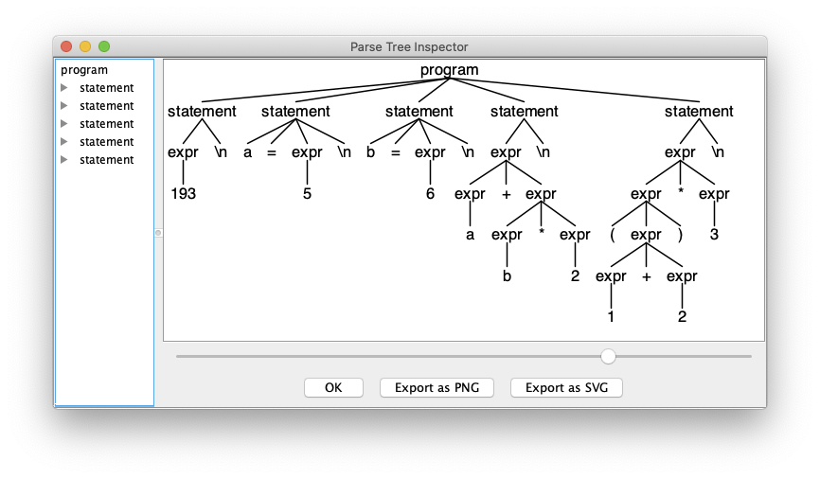
On the Command Line
ANTLR-ExprTestJava: ls
Expr.g4 ExprMain.java input.txt
ANTLR-ExprTestJava: antlr4 Expr.g4
ANTLR-ExprTestJava: ls
Expr.g4 ExprBaseListener.java ExprLexer.tokens ExprParser.java
Expr.interp ExprLexer.interp ExprListener.java input.txt
Expr.tokens ExprLexer.java ExprMain.java
ANTLR-ExprTestJava: javac Expr*.java
ANTLR-ExprTestJava: grun Expr program -gui input.txt

Slide 38
On the Command Line, cont’d
ANTLR-ExprTestJava: java ExprMain input.txt
Tokens:
[@0,0:2='193',<9>,1:0]
[@1,3:3='\n',<10>,1:3]
[@2,4:4='a',<8>,2:0]
[@3,6:6='=',<1>,2:2]
[@4,8:8='5',<9>,2:4]
[@5,9:9='\n',<10>,2:5]
[@6,10:10='b',<8>,3:0]
[@7,12:12='=',<1>,3:2]
[@8,14:14='6',<9>,3:4]
[@9,15:15='\n',<10>,3:5]
[@10,16:16='a',<8>,4:0]
[@11,17:17='+',<4>,4:1]
[@12,18:18='b',<8>,4:2]
[@13,19:19='*',<2>,4:3]
[@14,20:20='2',<9>,4:4]
[@15,21:21='\n',<10>,4:5]
[@16,22:22='(',<6>,5:0]
[@17,23:23='1',<9>,5:1]
[@18,24:24='+',<4>,5:2]
[@19,25:25='2',<9>,5:3]
[@20,26:26=')',<7>,5:4]
[@21,27:27='*',<2>,5:5]
[@22,28:28='3',<9>,5:6]
[@23,29:29='\n',<10>,5:7]
[@24,30:29='<EOF>',<-1>,6:0]
Parse tree (Lisp format):
(program (statement (expr 193) \n) (statement a = (expr 5) \n) (statement b = (expr 6) \n)
(statement (expr (expr a) + (expr (expr b) * (expr 2))) \n)
(statement (expr (expr ( (expr (expr 1) + (expr 2)) )) * (expr 3)) \n))

